Slide 1
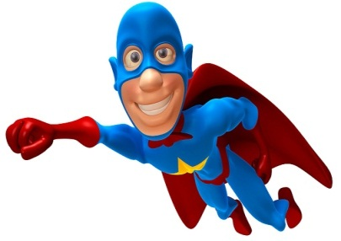
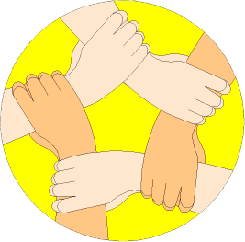
Which ones are you using?
Creative Thinker
Effective Participator
Independent Enquirer
Reflective Learner
Self Manager
Team Worker
PLT Skills
LESSON OBJECTIVES
We are learning to:
Finding connections between different words. (Which PLT skills?)
Accurately multiply and divide surds and simplify. (Grade 7)
Always aim high!
Where are we in our journey?
Real life cross/curricular links?
AUTHOR

Slide 2
Which ones are you using?
Creative Thinker
BRAIN IN GEAR
Team Worker
Effective Participator
Independent Enquirer
Reflective Learner
Self Manager
PLT Skills
EXAMPLE
DITDIONA can be rearranged to make ADDITION
TASK
Work out the following Mathematical anagrams:
ECASNEL
RAEA
RYFEUECQN
Scalene
Area
Frequency
EXTENSION
Develop your own Mathematical anagrams as above as a creative thinker.
Notes:
2

Slide 3
Which ones are you using?
Creative Thinker
Effective Participator
Independent Enquirer
Reflective Learner
Self Manager
Team Worker
STARTER
PLT Skills
TASK
17
Write 0.6 as a fraction
Write 3600000 in standard form
Write as a %
Find 45% of 60kg
1)
2)
3)
4)
20
Write 0.009 in standard form
Standard form:
7 x 10 x 2 x 10
Value of:
5)
6)
7)
8)
6
3
-
3
25
2
EXTENSION
Jarvis paid £170 for a suit that had been reduced by 15% in a sale. What was the original price?
Factorise the following:
x² - 7x + 12 = ( )( )
x - 4
x - 3
85% =
£170
÷ 85
÷ 85
1% =
£2
x 100
£200
x 100
100% =
Original Price
Notes:
3

Slide 4
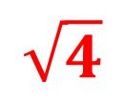
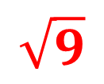
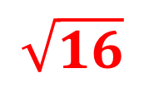
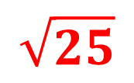
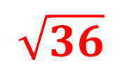
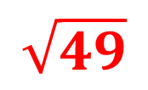
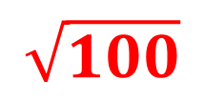
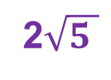
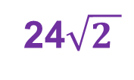
Which ones are you using?
Creative Thinker
Effective Participator
Independent Enquirer
Reflective Learner
Self Manager
Team Worker
PLT Skills
SIMPLIFYING SURDS
LEARN THESE OFF BY HEART
EXAMPLES
Simplify each of these following surds fully:
(a)
x
(b)
x
(c)
÷
(d)
÷
x
x
6
20
5
3
x
x
2
3
=
=
x
x
=
=
4
3
=
15
x
=
6
x
=
2
x
=
5
x
=
=
6
x
=
=
5
x
4
6
x
=
4
=
20
=
Notes:
4

Slide 5
Which ones are you using?
Creative Thinker
Effective Participator
Independent Enquirer
Reflective Learner
Self Manager
Team Worker
PLT Skills
SIMPLIFYING SURDS
Write each of the following surds in their simplest form:
TASK 1
TASK 2
TASK 3
EXTENTION
a) 2√18 × 3√2
b) 4√24 × 2√5
c) 3√12 × 3√3
d) 2√8 × 2√8
e) 2√27 × 4√8
f) 2√48 × 3√8
g) 2√45 × 3√3
h) 2√63 × 2√7
i) 2√32 × 4√2
j) √1000 × √10
k) √250 × √10
l) 2√98 × 2√2
a) 4√2 × 5√3
b) 2√5 × 3√3
c) 4√2 × 3√2
d) 2√2 × 2√8
e) 2√5 × 3√8
f) 3√3 × 2√3
g) 2√6 × 5√2
h) 5√7 × 2√3
i) 2√2 × 3√7
j) 2√2 × 3√18
k) 2√6 × 2√6
l) 4√5 × 3√6
a) 6√12 ÷ 2√3
b) 3√15 ÷ √3
c) 6√12 ÷ √2
d) 4√24 ÷ 2√8
e) 12√40 ÷ 3√8
f) 5√3 ÷ √3
g) 14√6 ÷ 2√2
h) 4√21 ÷ 2√3
i) 9√28 ÷ 3√7
j) 12√56 ÷ 6√8
k) 25√6 ÷ 5√6
l) 32√54 ÷ 4√6
a) 4√2 × √3 ÷ 2√2
b) 4√5 × √3 ÷√15
c) 2√32 × 3√2 ÷ 2√8
d) 6√2 × 2√8 ÷ 3√8
e) 3√5 × 4√8 ÷ 2√8
f) 12√3 × 4√3 ÷ 2√3
g) 3√8 × 3√12 ÷ 3√48
h) 4√7 × 2√3 ÷ 8√3
i) 15√2 × 2√7 ÷ 3√2
j) 8√2 × 2√18 ÷ 4√3
k) 5√6 × 5√6 ÷ 5√3
l) 2√5 × 3√6 ÷ √30
Notes:
5

Slide 6
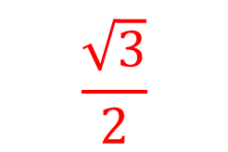
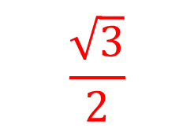
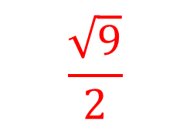
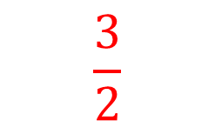
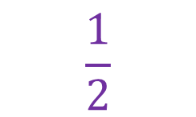
PLENARY ACTIVITY
GRADE A* QUESTION
Simplify the following surd:
(
2
(
=
X
=
1
=
=

