Slide 1
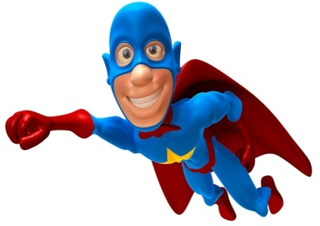
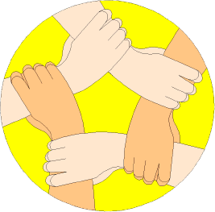
Which ones are you using?
Creative Thinker
Effective Participator
Independent Enquirer
Reflective Learner
Self Manager
Team Worker
PLT Skills
LESSON OBJECTIVES
We are learning to:
Finding connections between different words. (Which PLT skills?)
Accurately add and subtract surds. (Grade 7)
Always aim high!
Where are we in our journey?
Real life cross/curricular links?
AUTHOR

Slide 2
Which ones are you using?
Creative Thinker
BRAIN IN GEAR
Team Worker
Effective Participator
Independent Enquirer
Reflective Learner
Self Manager
PLT Skills
EXAMPLE
DITDIONA can be rearranged to make ADDITION
TASK
Work out the following Mathematical anagrams:
RUSAEQ
IYMSPLIF
TOOR
Square
Simplify
Root
EXTENSION
Develop your own Mathematical anagrams as above as a creative thinker.
Notes:
2

Slide 3
Which ones are you using?
Creative Thinker
Effective Participator
Independent Enquirer
Reflective Learner
Self Manager
Team Worker
STARTER
PLT Skills
TASK
Simplify the following surds:
1)
2)
3)
4)
5)
6)
7)
=
=
=
=
=
=
=
=
=
=
=
=
=
=
EXTENSION
=
=
=
=
x
=
x
=
Notes:
3

Slide 4
Which ones are you using?
Creative Thinker
Effective Participator
Independent Enquirer
Reflective Learner
Self Manager
Team Worker
PLT Skills
SUMS WITH SURDS
LEARN THESE OFF BY HEART
EXAMPLES
Simplify the following surds:
(a)
(b)
(c)
(d)
=
=
=
=
=
=
(e)
=
=
=
=
=
Notes:
4

Slide 5
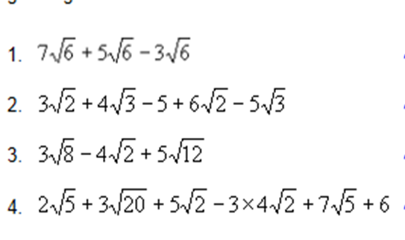
Which ones are you using?
Creative Thinker
Effective Participator
Independent Enquirer
Reflective Learner
Self Manager
Team Worker
PLT Skills
SUMS WITH SURDS
TASK 1
TASK 3
Simplify:
Simplify:
1)
1)
2)
2)
3)
3)
4)
4)
5)
5)
= 16
6)
EXTENSION
TASK 2
Simplify:
Simplify:
1)
=
1)
2)
2)
=
3)
3)
=
4)
5)
=
4)
Notes:
5

Slide 6
Which ones are you using?
Creative Thinker
Effective Participator
Independent Enquirer
Reflective Learner
Self Manager
Team Worker
PLT Skills
SUMS WITH SURDS
MINI-PLENARY
Simplify the following surd:
=
=
=
=
Notes:
6

Slide 7
PLENARY ACTIVITY
Simplify fully:
You must show your working.
=
=
=
=
2

