Slide 1
Recurring decimals
Changing recurring decimals into fractions and vice versa.
If you have any questions regarding these resources or come across any errors, please contact
helpful-report@pixl.org.uk

Slide 2
Key vocabulary
Recurring
Fraction
Decimal
Solve
Equation

Slide 3
How to write recurring decimals
0.33333333… Can be written as 0.$\dot{3}$
The dot shows which digit is recurring
0.24242424… Can be written as 0.$\dot{2}\dot{4}$
Two digits both recur
0.714714714… Can be written as 0.$\dot{7}1\dot{4}$
The whole section between 7 and 4 recurs
0.652146521465..… Can be written as 0.$\dot{6}521\dot{4}$
The whole section between 6 and 4 recurs

Slide 4
Change recurring decimals into fractions
Change the following fractions into decimals and identify whether the answer is a recurring decimal or terminating decimal:
1) $\frac{3}{8}$ 2) $\frac{5}{6}$
Is the same as 3÷8
Is the same as 5÷6
0 . 3 7 5
8) 3 .0 0 0
- 0
3 0
- 2 4
6 0
- 5 6
4 0
- 4 0
0
0 . 8 3 3…..
6) 5 .0 0 0
- 0
5 0
- 4 8
2 0
- 1 8
2 0
- 1 8
2
3 is recurring
=0.8$\dot{3}$
8x3=24
6x8=48
8x7=56
6x3=18
8x5=40
6x3=18
Terminating decimal
Recurring decimal

Slide 5
Change recurring decimals into fractions
Change 0.$\dot{8}$ into a fraction
Let X = 0.88888888……
Only one digit is recurring so multiply by 10
10X = 8.888888888……
- X = 0.888888888……
9X = 8
X = $\frac{8}{9}$
Subtract the two
Divide both sides by 9
0.$\dot{8}$ = $\frac{8}{9}$

Slide 6
Change recurring decimals into fractions
Change 0.$\dot{7}\dot{9}$ into a fraction
Let X = 0.7979797979……
Two digits are recurring so multiply by 100
100X = 79.797979797……
- X = 0.7979797979……
99X = 79
X = $\frac{79}{99}$
Subtract the two
Divide both sides by 99
0.$\dot{7}\dot{9}$ = $\frac{79}{99}$

Slide 7
Change recurring decimals into fractions
Change 0.$1\dot{3}\dot{6}$ into a fraction
Let X = 0.$1\dot{3}\dot{6}$ 10X = 1. $\dot{3}\dot{6}$ 1000X=136. $\dot{3}\dot{6}$
1000X = 136.3636363……
- 10X = 1.363636363……
990X = 135
X = $\frac{135}{990}$ = $\frac{27}{198}$ = $\frac{3}{22}$
Subtract the two
Divide both sides by 990
÷ 5
÷ 9
Simplify the fraction
÷ 5
÷ 9
0.$1\dot{3}\dot{6}$ = $\frac{3}{22}$

Slide 8
Practice solutions
Convert $\frac{4}{9}$ into a decimal
Change 0. $\dot{9}\dot{1}$ into a fraction
Change the following fractions into decimals and state whether they are recurring decimals or terminating decimals
(i) $\frac{3}{20}$ (ii) $\frac{17}{45}$
Convert $\frac{25}{33}$ into a decimal
Change 0.4$\dot{5}$ into a fraction
Change the following fractions into decimals and state whether they are recurring decimals or terminating decimals
(i) $\frac{8}{37}$ (ii) $\frac{3}{16}$
= 0.$\dot{4}$
= $\frac{91}{99}$
= 0.15
Terminating decimal
= 0.3$\dot{7}$
Recurring decimal
= 0.$\dot{7}\dot{5}$
= $\frac{41}{90}$
= 0.$\dot{2}$1$\dot{6}$
Recurring decimal
= 0.1875
Terminating decimal

Slide 9
Problem solving and reasoning
Prove that the recurring decimal 0. $\dot{7}\dot{2}$ = $\frac{8}{11}$
Let X = 0.72727272……
Two digits are recurring so multiply by 100
100X = 72.72727272……
- X = 0.7272727272……
99X = 72
X = $\frac{72}{99}$ =
Subtract the two
Divide both sides by 99
÷ 9
$$\frac{8}{11}$$
Simplify the fraction
÷ 9

Slide 10
Problem solving and reasoning
The recurring decimal 0. $\dot{5}\dot{7}$ can be written as the fraction $\frac{19}{33}$
Write the decimal 0.$5\dot{5}\dot{7}$ as a fraction in its simplest form
0.$0\dot{5}\dot{7}$ can be written as $\frac{19}{330}$
0.$5$ = $\frac{1}{2}$ = $\frac{165}{330}$
$\frac{19}{330}$ +$\frac{165}{330}$ = $\frac{184}{330}$ = $\frac{92}{165}$
0.$5\dot{5}\dot{7 }$ = $\frac{92}{165}$

Slide 11
Exam specimen questions

Slide 12
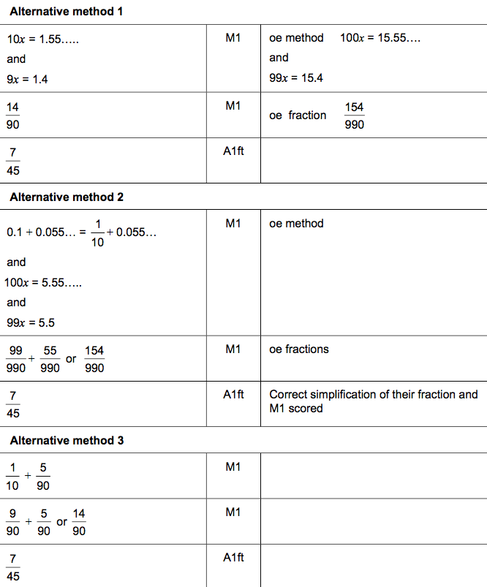
Exam specimen questions

Slide 13
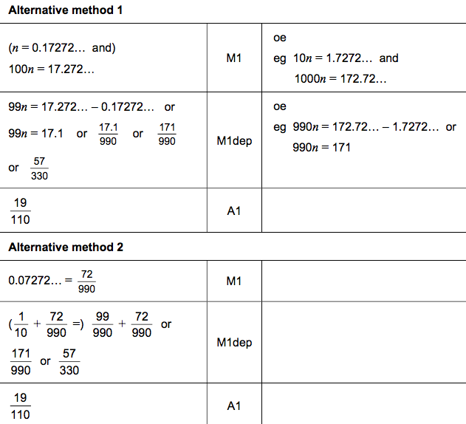
Exam specimen questions

Slide 14
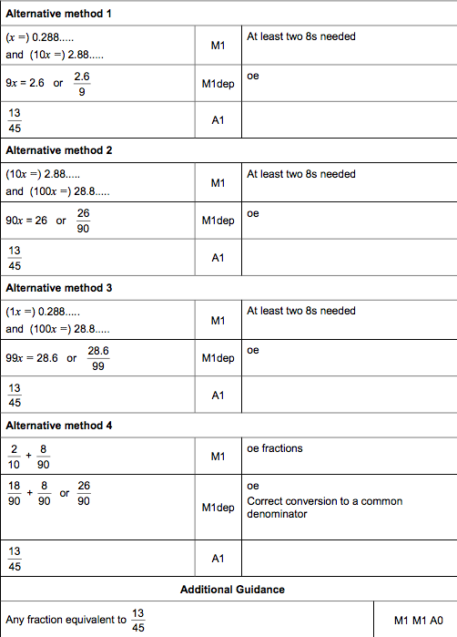
Exam specimen questions

Slide 15
Exam specimen questions

Slide 16
Exam specimen questions

Slide 17
Exam specimen questions
[2 marks]

Slide 18
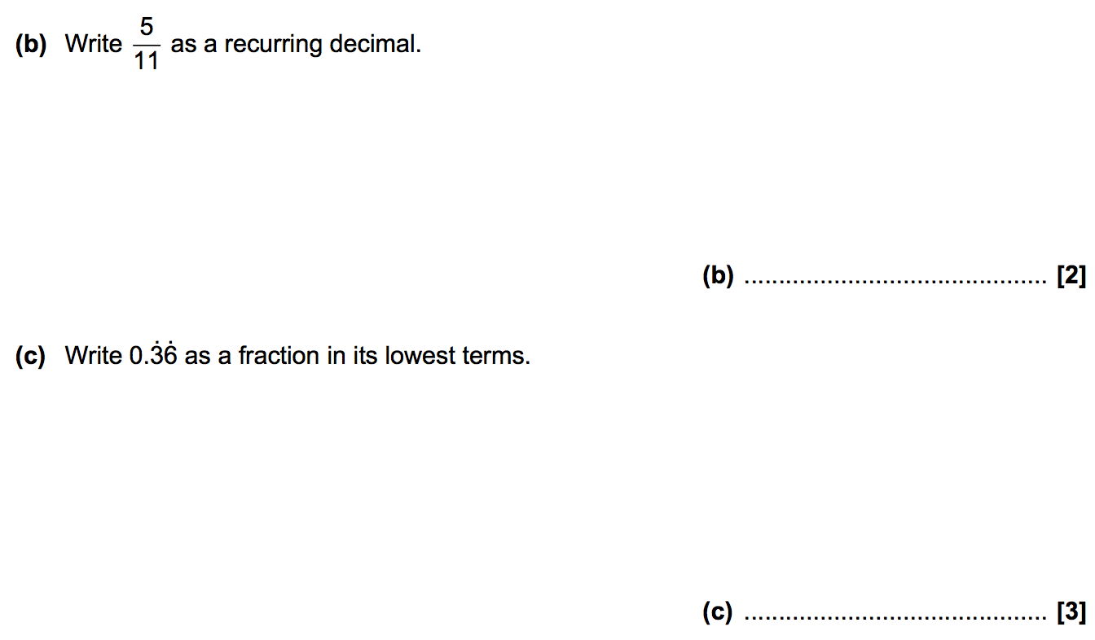
Exam specimen questions

