Slide 1
Gradient and Area Under Curve
Calculate or estimate gradients of graphs and areas under graphs (including quadratic and other non-linear) interpreting results in cases such as distance-time, velocity-time and financial contexts
If you have any questions regarding these resources or come across any errors, please contact
helpful-report@pixl.org.uk

Slide 2
Key vocabulary
Gradient
Estimate
Linear
Non-linear
Quadratic
Velocity

Slide 3
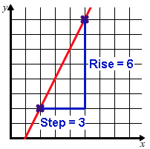
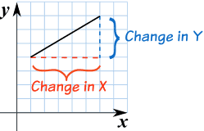
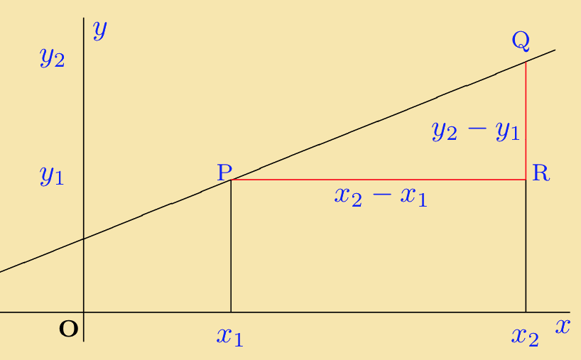
Gradient from a linear graph
A linear graph is a straight line graph with an equation which can be written in the form y = mx + c
The gradient is ‘m’ and can be found from the graph
Change in y
Change in x
Rise
Step
y₂ – y₁
x₂ – x₁

Slide 4
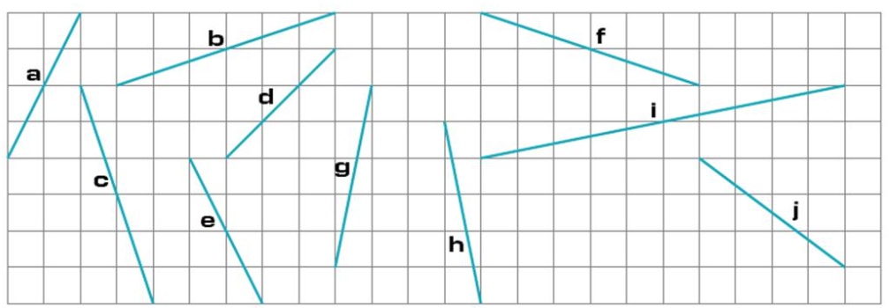
Find the gradients of these lines:
a = 2
b = 1/3
c = -3
d = 1
e = -2
f = -1/3
g = 5
h = -5
i = 1/5
j = -3/4

Slide 5
Gradient from a linear equation
Rearrange this equation to make y the subject and identify the gradient of this linear graph.
2y - 5x + 8 = 0
2y = 5x - 8
y = x - 4
Gradient =

Slide 6
Gradient from a linear equation
Rearrange this equation to make y the subject and identify the gradient of this linear graph.
PRACTICE
4x – 2y = 12
y – 4x = 8
y – 8 = -1/2(x + 4)
3x – 4y = 8
3y + 4x - 9 = 0
3y = -4x + 9
y = x + 3
y = 2x - 6
y = 4x + 8
y = -1/2x + 6
Gradient =
y = 3/4x -2

Slide 7
Gradient of a quadratic graph
This is a quadratic graph with equation y = x²
y
We can estimate the gradient of this graph at the point (2,4) by considering points just above and just below x= 2
ie x = 2.1 and x = 1.9
Between x = 2.1 and x = 1.9
Gradient =
4.41 – 3.61
2.1 – 1.9
x
= 4
We can do this more efficiently and accurately by drawing a tangent at the point (2,4) and then finding the gradient of this line.

Slide 8
Gradient of a quadratic graph
y
4
1
= 4
x
We can do this more efficiently and accurately by drawing a tangent at the point (2,4) and then finding the gradient of this line.

Slide 9
Gradient of a quadratic graph
This is a quadratic graph with equation y = x²- 3x + 1
y
Estimate the gradient of this graph at the point (0,1)
-3
1
= -3
x

Slide 10
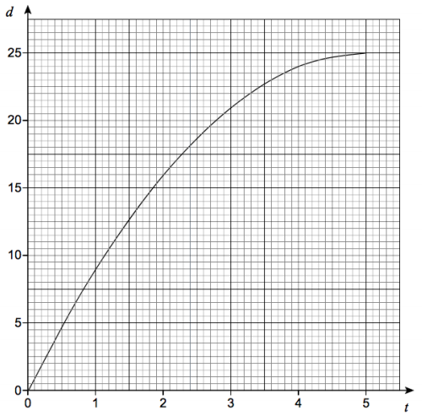
Gradient of a quadratic graph contextualised
2
A container is filled with water in 5 seconds. The graph shows the depth of the water, d cm, at the time, t seconds.
Use the graph to estimate the rate at which the depth of water is increasing at 3 seconds.
8
8
2
= 4
Note that exam mark schemes will allow for some degree of error (3.5 – 4.5 in this case)
4

Slide 11
Interpreting gradient
In this conversion graph the gradient is 2. This means for every 1 unit of x, you need 2 units of y or the value of y is double the value of x.
Y axis
X axis

Slide 12
Gradients of zero
x = -8/3
y
At these points on the graph the gradient is zero (flat)
x
x = 0

Slide 13
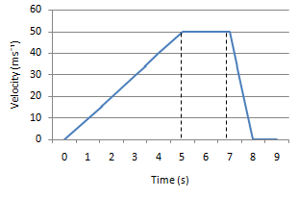
Velocity time graphs
The gradient of a velocity-time graph represents acceleration or deceleration at that point.
The units are m/s⁻²
The area under a velocity-time graph represents the distance travelled.
The units here are metres.
This can be estimated by splitting the area under the graph into sections, calculating each one and then adding them together.
0 1 2 3 4 5 6 7 8 9

Slide 14
Velocity time graphs practice
A toy car is placed on the floor of a sports hall.
It moves in a straight line starting from rest.
It travels with constant acceleration for 4 seconds reaching a velocity of 5m/s.
It then slows down with constant deceleration of 1m/s² for 2 seconds.
It then hits a wall and stops.
Draw the velocity – time graph
Work out the total distance travelled by the toy car
0.5 (4 x 5) + 0.5 (5 + 3) x 2
= 18m

Slide 15
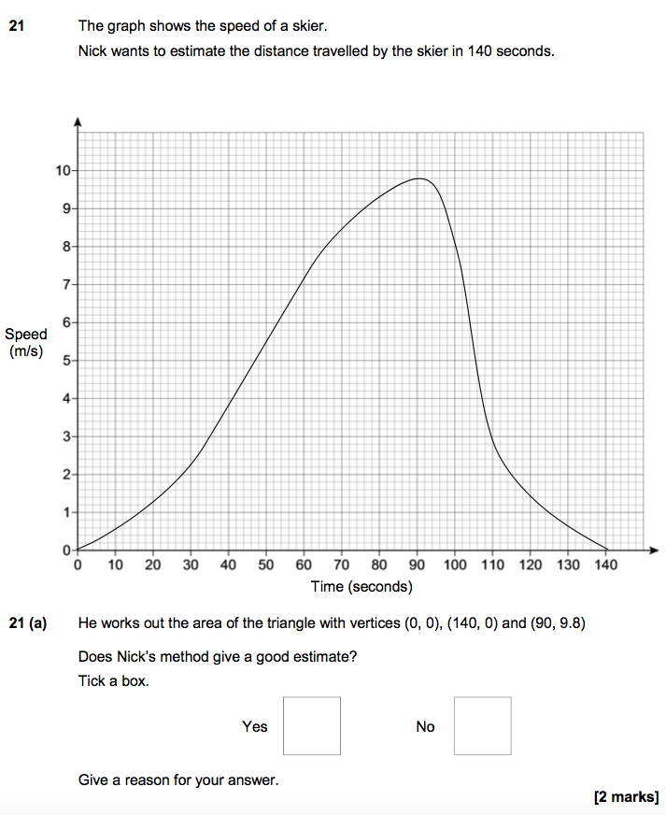
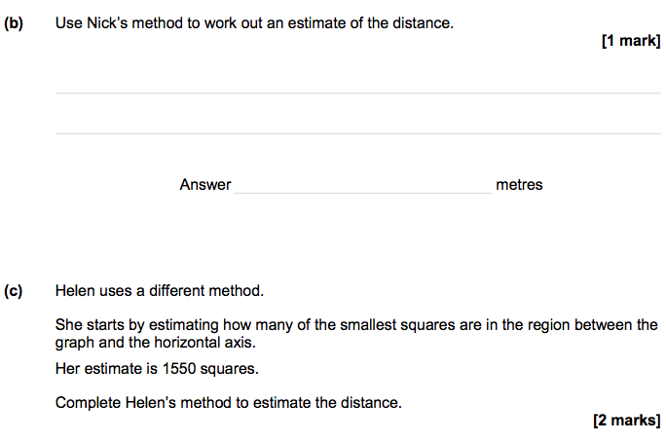
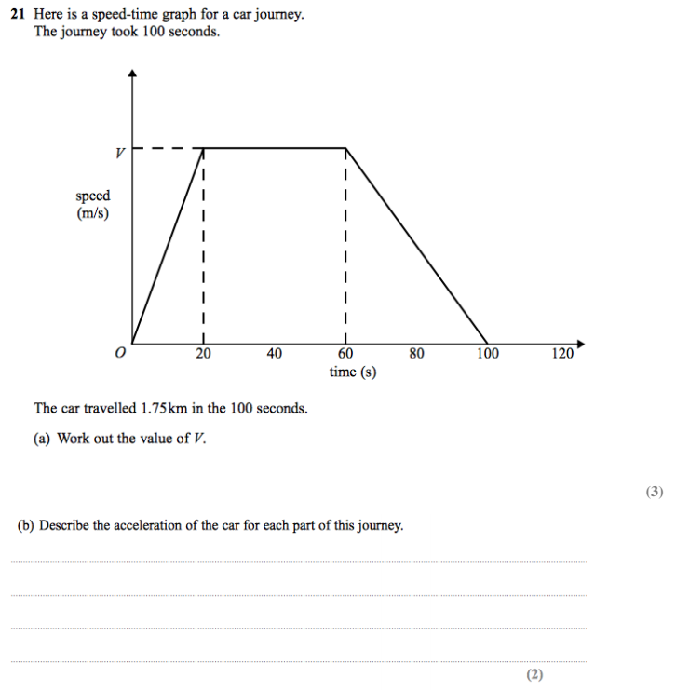
Exam specimen questions
Student Sheet 8

Slide 16
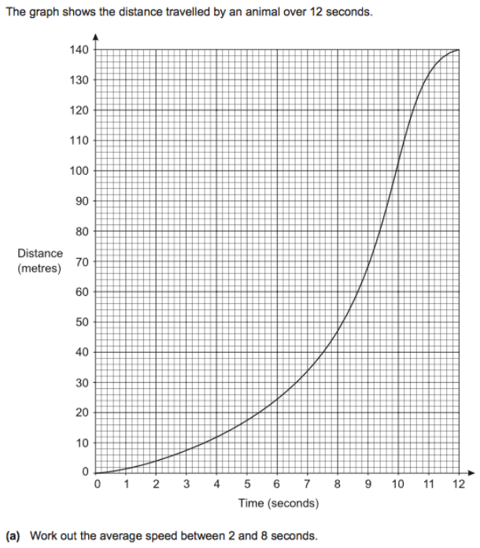
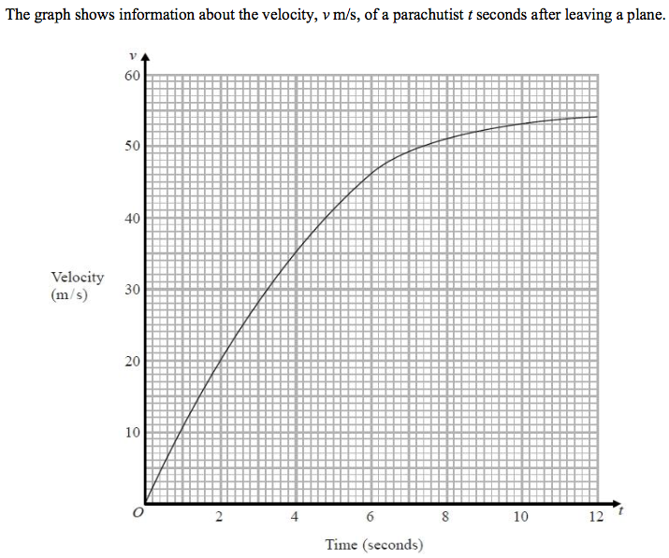
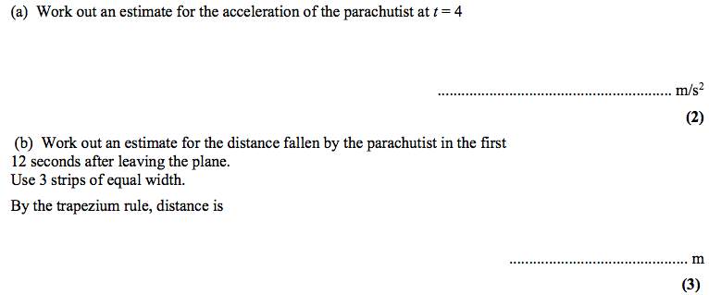
Exam specimen questions
Curve 2.0 Related Question
Student Sheet 9

Slide 17
Exam specimen questions

Slide 18
Exam specimen questions

Slide 19
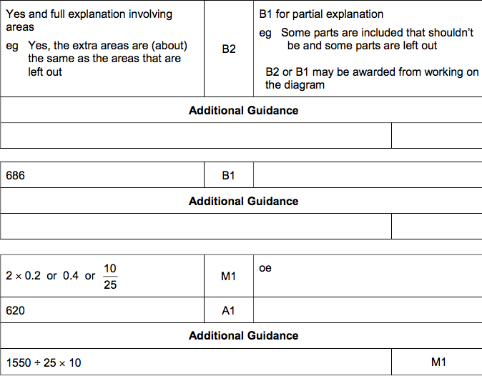
Exam specimen questions

Slide 20
Exam specimen questions

