Slide 1
Trig Identities
Thursday, 02 February 2012

Slide 2
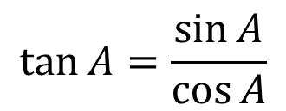
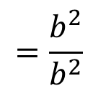
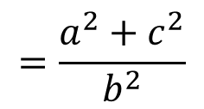
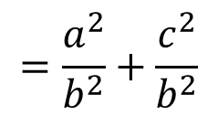
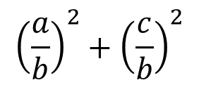
Right angled Triangle Trigonometry
C
a
b
B
A
c
$${\left(\frac{a}{b}\right)}^{2}+{\left(\frac{c}{b}\right)}^{2}$$
$$=\frac{a^{2}}{b^{2}}+\frac{c^{2}}{b^{2}}$$
$$=\frac{a^{2}+c^{2}}{b^{2}}$$
$$=\frac{b^{2}}{b^{2}}$$
$$\sin^{2}{A}+\cos^{2}{A}=$$
$$=1$$
$$\sin^{2}{A}+\cos^{2}{A}=1$$

Slide 3
Example
Solve the equation $2\sin^{2}{x}+\sin{x}−1=0$ for values of $x$ in the range of 0° to 360°
S
A
S
A
30°
30°
T
C
T
C
x = 150°
x = 30°
x = 30°, 150°, 270°

Slide 4
Example
Solve the equation $3\sin^{2}{x}+5\cos{x}=1$for values of $x$from 0 to 360.
S
A
S
A
109.5°
109.5°
T
C
T
C
x = 109.5°, 250.5°
x = 109.5°
x = 250.5°

Slide 5
Example
Solve the equation $3\sin^{2}{x}+10\cos{x}−6=0$ for values of $x$ in the range of 0° to 360°
S
A
S
A
109.5°
109.5°
T
C
T
C
x = 109.5°, 250.5°
x = 109.5°
x = 250.5°

Slide 6
Example
Solve the equation $2\sin{x}=3\cos{x}$ for values of $x$ in the range $0°≤x≤360°$
S
A
S
A
56.3°
56.3°
T
C
T
C
x = 236.3°
x = 56.3°
x = 56.3°, 236.3°

Slide 7
Example
Solve the equation
in the range 0 to 360°
S
A
S
A
48.6°
48.6°
T
C
T
C
x = 228.6°
x = 311.4°
x = 0°, 180°, 228.6°, 311.4°, 360°

Slide 8
A Level past paper Question 1
Find all the values of x in the interval satisfying the equation
Find all the values of x in the interval satisfying the equation

Slide 9
A Level past paper Question 2
Find the values of x between 0° and 360° satisfying the equation

Slide 10
3. Solve the equation $5\sin{x}=2\cos{x}$ for values of $x$ in the range
$0°≤x≤360°$
4. Solve the equation $\sin{x}+\sqrt{3}\cos{x}=0$ for values of $x$ in the range
$0°≤x≤360°$

