Slide 1
Right Angled Trigonometry
Tuesday, 04 March 2014

Slide 2
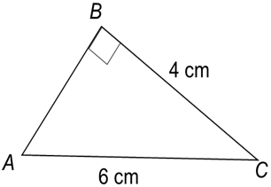
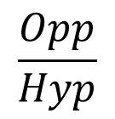
Example
Calculate the size of angle A in the triangle ABC
Opp
$$\frac{Opp}{Hyp}$$
Adj
$$\sin{A}=$$
$$\frac{4}{6}$$
$$\sin{A}=$$
Hyp
$$A=$$
$$\sin^{−1}\left(0.66\right)$$
$$A=$$
$$41.8°$$

Slide 3
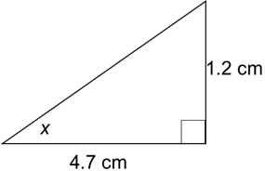
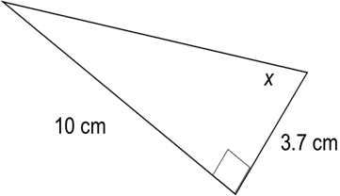
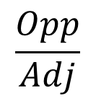

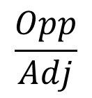

Example
Find the size of angle x in each of the following
(i)
(ii)
$$\frac{Opp}{Adj}$$
$$\tan{A}=$$
$$\frac{1.2}{4.7}$$
$$\operatorname{Tan}{X}=$$
$$X=$$
$$\tan^{−1}\left(0.255\right)$$
$$X=$$
$$14.32°$$
$$\frac{Opp}{Adj}$$
$$\tan{A}=$$
$$\frac{10}{3.7}$$
$$\tan{X}=$$
$$X=$$
$$\tan^{−1}\left(2.70\right)$$
$$X=$$
$$69.70°$$

Slide 4
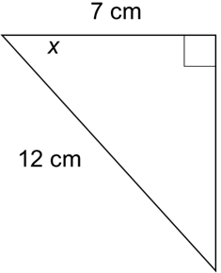
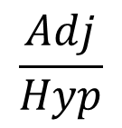
(iii)
$$\frac{Adj}{Hyp}$$
$$\cos{A}=$$
$$\frac{7}{12}$$
$$\operatorname{Cos}{X}=$$
$$X=$$
$$\cos^{−1}\left(0.583\right)$$
$$X=$$
$$54.31°$$

Slide 5
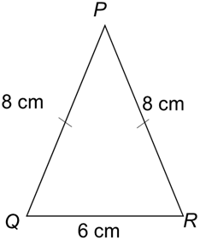
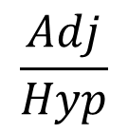
Example
Calculate the size of angle PQR in the triangle below.
P
$$\frac{Adj}{Hyp}$$
$$\cos{A}=$$
→
8
$$\frac{3}{8}$$
$$\operatorname{Cos}{Q}=$$
$$Q=$$
$$\cos^{−1}\left(0.375\right)$$
Q
3
$$Q=$$
$$68.0°$$

Slide 6
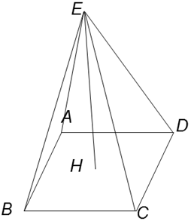
Example
The figure is a pyramid on a square base ABCD. The edges of the base are 30cm long and the height, EH, of the pyramid is 42cm. Find
a) the length of AC
b) the angle EAH

Slide 7
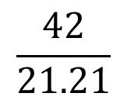
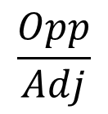
a) the length of AC
Using pythagoras theorem with the base
42cm
A
D
$$AC=\sqrt{{30}^{2}+{30}^{2}}$$
30cm
30cm
$$AC=42.42$$
30cm
B
C
30cm
b) the angle EAH
$$\frac{Opp}{Adj}$$
E
$$\tan{A}=$$
Draw the right angled triangle for EAH
$$\frac{42}{21.21}$$
42cm
$$\tan{A}=$$
$$A=$$
$$\tan^{−1}\left(0.1.97\right)$$
A
H
$$A=$$
$$63.2°$$
21.21cm

Slide 9
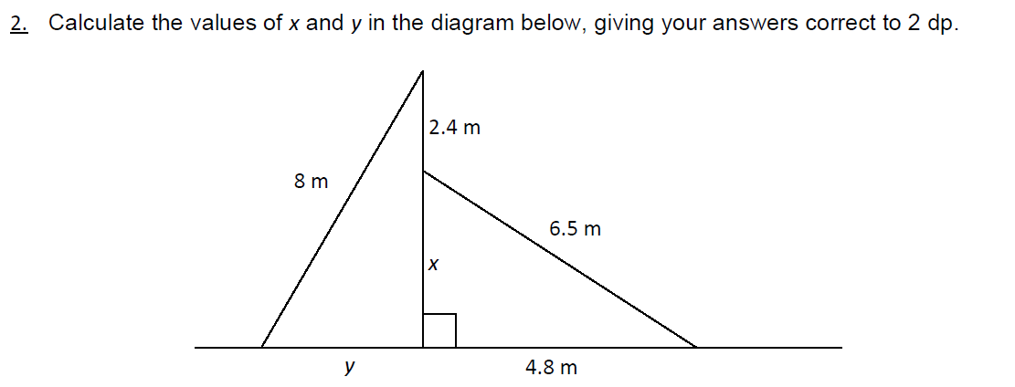

Slide 11
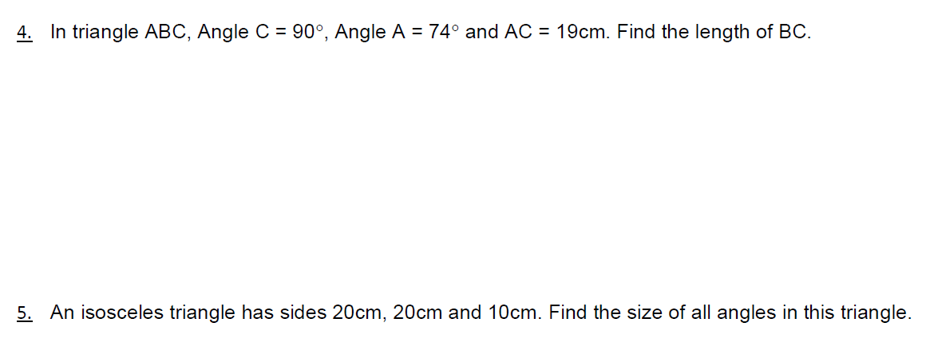

Slide 12
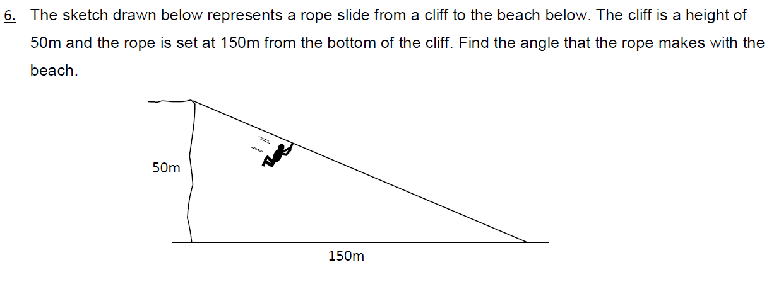

Slide 13
