Slide 1
Stationary Points
Friday, 07 December 2012

Slide 2
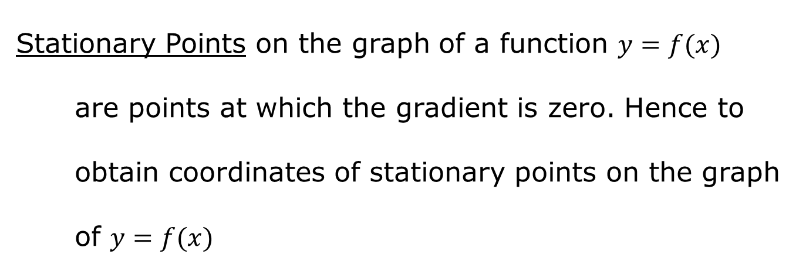
Stationary Points on the graph of a function $y=f(x)$ are points at which the gradient is zero. Hence to obtain coordinates of stationary points on the graph of $y=f(x)$
Solve $\frac{dy}{dx}=0$ -gives the $x$ coordinates then
Substitute in $y=f(x)$ -gives the $y$ coordinates

Slide 3
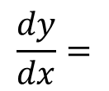
Example
Find the stationary point of $y=2−4x+x^{2}$
$$\frac{dy}{dx}=$$
$$−4$$
$$+2x$$
For stationary points
$$−4+2x=0$$
$$2x=4$$
$$x=2$$
$$y=2−4\left(2\right)+{\left(2\right)}^{2}$$
$$y=2−8+4$$
$$y=−2$$
stationary points at $(2, −2)$
NB Being a quadratic function the stationary point will be the vertex.

Slide 4
Example
Given $y=2x^{3}+3x^{2}+1$ obtain the stationary points and sketch the graph.
$$\frac{dy}{dx}=$$
$$6x^{2}$$
$$+6x$$
For stationary points
$$6x^{2}+6x=0$$
$$6x\left(x+1\right)=0$$
$$x=0$$
$$x=−1$$
2
$$y=1$$
$$y=2{\left(−1\right)}^{3}+3{\left(−1\right)}^{2}+1$$
$$y=2$$
1
stationary points at $(0,1)$ and $\left(−1,2\right)$
0
-1

Slide 5
Stationary points will be one of the following types:
Minimum point
Maximum point
Points of inflection

Slide 6
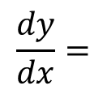
Example
Obtain the stationary points and determine type for the graph of $y=2x^{3}+3x^{2}−36x+6$
$$\frac{dy}{dx}=$$
$$6x^{2}$$
$$+6x$$
$$−36$$
For stationary points
$$6x^{2}+6x−36=0$$
$$x^{2}+x−6=0$$
$$\left(x−2\right)\left(x+3\right)=0$$
$$x=2$$
$$x=−3$$
$$y=−38$$
$$y=2{\left(−3\right)}^{3}+3{\left(−3\right)}^{2}−36\left(−3\right)+6$$
$$y=87$$
stationary points at $(2,−38)$ and $\left(−3,87\right)$

Slide 7
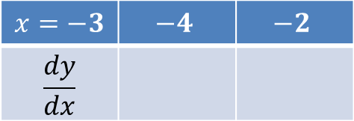
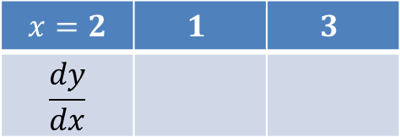
For nature (type) of Stationary points
Look at the change in gradient
$$\frac{dy}{dx}=6x^{2}+6x−36$$
$$x=2$$ | $$1$$ | $$3$$
$$\frac{dy}{dx}$$
+
–
$$−$$
$$+$$
Minimum at $\left(2,−38\right)$
$$x=−3$$ | $$−4$$ | $$−2$$
$$\frac{dy}{dx}$$
$$+$$
$$−$$
+
–
Maximum at $\left(−3,87\right)$

Slide 8
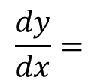
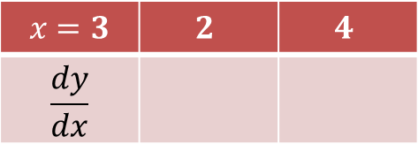
Example
Obtain the stationary points and determine type for the graph of $y=4+6x−x^{2}$
$$\frac{dy}{dx}=$$
$$6$$
$$−2x$$
For stationary points
For nature
$$6−2x=0$$
$$x=3$$ | $$2$$ | $$4$$
$$\frac{dy}{dx}$$
$$2x=6$$
$$+$$
$$−$$
+
–
$$x=3$$
$$y=4+6\left(3\right)−{\left(3\right)}^{2}$$
Maximum at $\left(3,13\right)$
$$y=13$$
stationary points at $(3, 18)$

Slide 9
We can determine type of any stationary point by looking at the change in its gradient as we go ‘through’ the stationary point.
+
–
–
+
+
–
+
–
Minimum
Maximum
Inflections

Slide 10
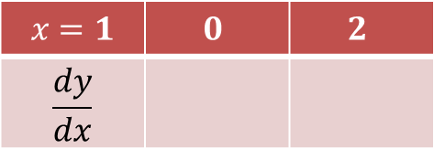
Example
Obtain the stationary points and determine type for the graph of $y=x^{3}+3x^{2}+3x$
$$\frac{dy}{dx}=$$
$$3x^{2}$$
$$+6x$$
$$+3$$
For stationary points
For nature
$$3x^{2}+6x+3=0$$
+
$$x=1$$ | $$0$$ | $$2$$
$$\frac{dy}{dx}$$
$$x^{2}+2x+1=0$$
$$\left(x+1\right)\left(x+1\right)=0$$
$$+$$
$$+$$
+
$$x=1$$
$$y=1$$
Point of inflection at $\left(1,1\right)$
stationary point at $(1,1)$

Slide 11
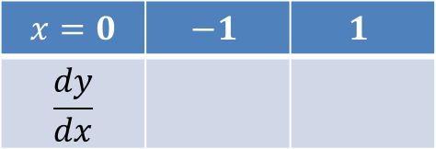
Example
Obtain the stationary points and determine type for the graph of $y=x^{3}−3x^{2}+1$
$$\frac{dy}{dx}=$$
$$3x^{2}$$
$$−6x$$
For stationary points
For nature
$$3x^{2}−6x=0$$
$$x=0$$ | $$−1$$ | $$1$$
$$\frac{dy}{dx}$$
$$−$$
$$+$$
$$3x\left(x−2\right)=0$$
$$+$$
$$−$$
$$x=0$$
$$x=2$$
Maximum at $\left(0,1\right)$
$$y=1$$
$$y={\left(2\right)}^{3}−3{\left(2\right)}^{2}+1$$
$$y=−3$$
$$x=2$$ | $$1$$ | $$3$$
$$\frac{dy}{dx}$$
$$−$$
$$+$$
$$−$$
$$+$$
stationary points at
$(0,1)$ and $\left(2,−3\right)$
Minimum at $\left(2,−3\right)$

Slide 12
1
0
2
-3

Slide 13
Questions
Find the stationary point of $y=2x^{2}−4x+3$
Obtain the stationary point and type for the curve $y=x^{2}+6x−1$

Slide 14
3. (a) Find the stationary points and type for the curve $y=x^{3}+3x^{2}+3x+2$
(b) Hence sketch the graph of $y=x^{3}+3x^{2}+3x+2$

Slide 15
4. (a) Obtain the coordinates of stationary points on the graph of
$y=x^{3}−3x^{2}+8$ and determine their type through change of sign of
gradient.
(b) Sketch the graph of $y=x^{3}−3x^{2}+8$

Slide 16
5. (a) Obtain the coordinates of stationary points on the graph of
$y=4x^{3}−12x$ and determine their type through change of sign of
gradient.
(b) Sketch the graph of $y=4x^{3}−12x$

