Slide 1
Inequalities
Wednesday, 13 November 2013

Slide 2
Solving inequalities
Example
Solve the inequality $2x+4<17$
$$2x+4<17$$
$$2x<17−4$$
$$2x<13$$
$$x<6.5$$
Example
Solve the inequality $3x−1≤2x+4$
$3x−2x≤4+1$
$x≤5$

Slide 3

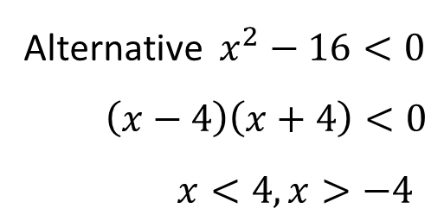
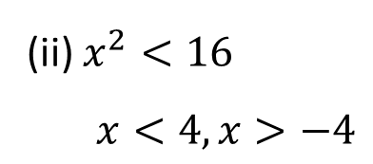
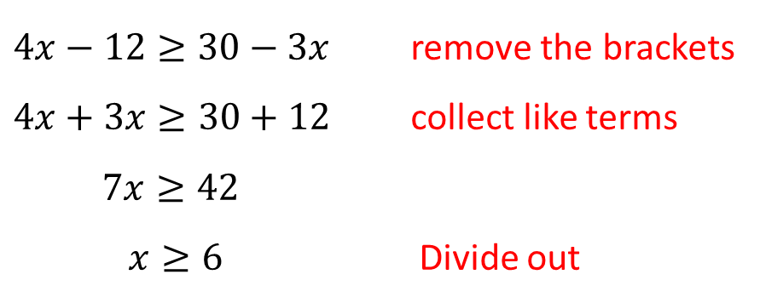
Example
Solve each of the following inequalities
(i) $4\left(x−3\right)≥3\left(10−x\right)$
(ii) $x^{2}<16$
(i) $4\left(x−3\right)≥3\left(10−x\right)$
$4x−12≥30−3x$ remove the brackets
$4x+3x≥30+12$ collect like terms
$7x≥42$
$x≥6$ Divide out
(ii) $x^{2}<16$
$x<4, x>−4$
Alternative $x^{2}−16<0$
$\left(x−4\right)\left(x+4\right)<0$
$x<4, x>−4$
-4
4

Slide 4
Quadratic inequalities
Example
Find the range of values of x for which $x^{2}−x−2>0$
Procedure:
1. Write in the form $ax^{2}+bx+c>0$ or $ax^{2}+bx+c<0$
2. Factorise and obtain critical values of $x$ for
which $ax^{2}+bx+c=0$
3. Draw a sketch of the quadratic showing the
critical values and make your judgement!

Slide 5
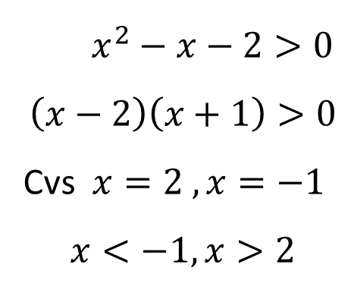
$x^{2}−x−2>0$
$$\left(x−2\right)\left(x+1\right)>0$$
Cvs $x=2 , x=−1$
$$x<−1, x>2$$
factorise
Obtain the critical values
-1
2
Write down solution
Place critical values onto curve

Slide 6
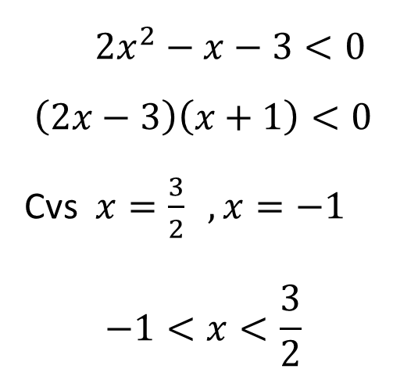
Example
Solve the inequality $2x^{2}−x−3<0$
${2x}^{2}−x−3<0$
$$\left(2x−3\right)\left(x+1\right)<0$$
Cvs $x=\frac{3}{2} , x=−1$
$$−1<x<\frac{3}{2}$$
-1
$$\frac{3}{2}$$

Slide 7
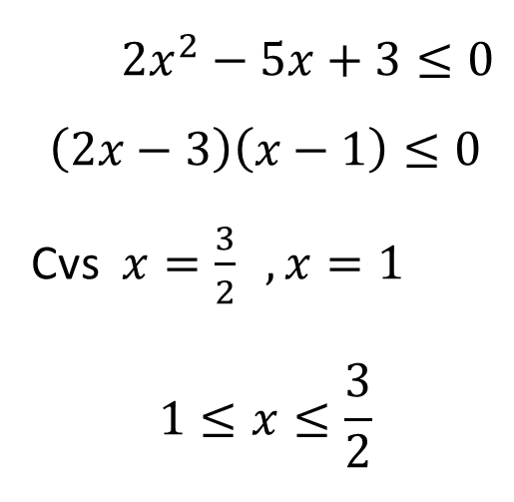
Example
Solve the inequality $2x^{2}+3≤5x$
${2x}^{2}−5x+3≤0$
$$\left(2x−3\right)\left(x−1\right)≤0$$
Cvs $x=\frac{3}{2} , x=1$
$$1≤x≤\frac{3}{2}$$
$$1$$
$$\frac{3}{2}$$

Slide 8
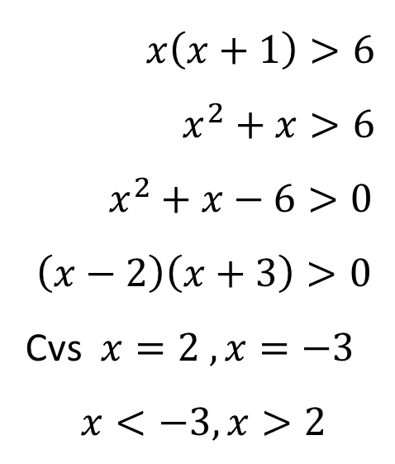
Example
Solve the inequality $x\left(x+1\right)>6$
$x\left(x+1\right)>6$
$x^{2}+x>6$
$x^{2}+x−6>0$
$$\left(x−2\right)\left(x+3\right)>0$$
Cvs $x=2 , x=−3$
$$x<−3, x>2$$
-3
2

Slide 9
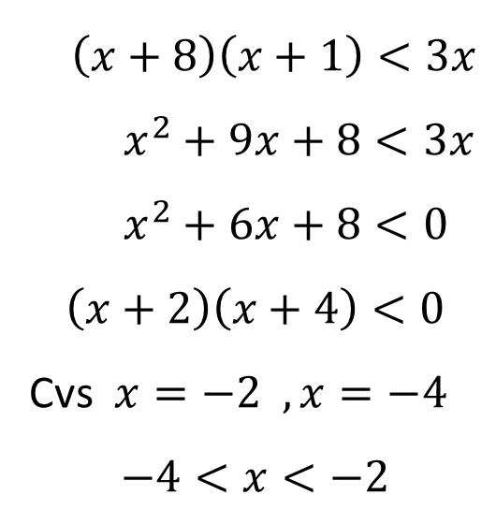
Example
Solve the inequality $\left(x+8\right)\left(x+1\right)<3x$
$\left(x+8\right)\left(x+1\right)<3x$
$x^{2}+9x+8<3x$
$x^{2}+6x+8<0$
$$\left(x+2\right)\left(x+4\right)<0$$
Cvs $x=−2 , x=−4$
$$−4<x<−2$$
$$−4$$
-2

Slide 10

Questions
Solve each of the following inequalities
$4x+8<24$
$3x+1≥2x−3$
$5x+2>2x+14$
$3t≥25−2t$
$u−5>37−5u$
$5w+12≤8w+6$
Answer
Answer
Answer
Answer
Answer
Answer

Slide 11
2. Solve each of the following inequalities
$x^{2}+8x+15<0$
$x^{2}+x−12≥0$
${2x}^{2}<5x+3$
$x^{2}+3x+7<14x−23$
Answer
Answer
Answer
Answer

Slide 12
3. Solve the inequality $x^{2}+8x+6≥3x$
Answer
4. Solve the inequality ${2x}^{2}−5x+5≥2x−1$
Answer

Slide 13
5. Solve the inequality $x\left(x+4\right)<4−2x^{2}$
Answer

