Slide 1
“eff” of x
Wednesday, 25 June 2014

Slide 2
Functions
$f(x)$ which reads “eff of ex” is used to indicate a function of $x$
A function is simply an expression in terms of $x$.
Examples
$$f(x) = 2x2−x−3$$
A quadratic function
$$f(x) = 4x−5$$
A linear function
$$f(x) = sinx$$
A trig function

Slide 3
Example
Given $f\left(x\right)=x^{2}+2x−5$ obtain (i) an expression for $f(a)$
(ii) the value of $f(4)$
(iii) the solutions of the equation $f(a) = 3$.
(i) $f\left(a\right)=a^{2}+2a−5$
(ii) $f\left(4\right)=4^{2}+2\left(4\right)−5$
$$=16+8−5$$
$$=19$$
(iii) $f\left(a\right)=3$
$$a^{2}+2a−5=3$$
$$a^{2}+2a−8=0$$
$$\left(a+4\right)\left(a−2\right)=0$$
$$a=−4$$
$$a=2$$

Slide 4

Example
Given $f(x) = 4 – 2x$
Work out $f(3)$
Solve the equation $f(m) = 7$
(i) $f(3) = 4 – 2\left(3\right)$
$$= 4 –6$$
$$=−2$$
(ii) $f(m) = 7$
$$4−2m = 7$$
$$4−7 =2m$$
$$−\frac{3}{2} =m$$

Slide 5
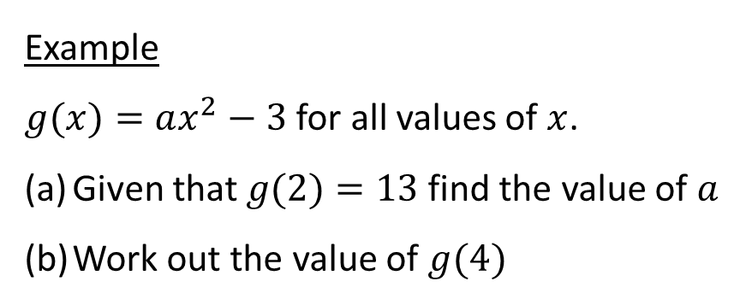
Example
$g(x)=ax^{2}−3$for all values of $x$.
Given that $g(2)=13$find the value of $a$
Work out the value of $g(4)$
(a)
$$g(2)=13$$
(b)
$$g\left(4\right)=4{\left(4\right)}^{2}−3$$
$$a{\left(2\right)}^{2}−3=13$$
$$=4×16−3$$
$$4a−3=13$$
$$=61$$
$$4a=16$$
$$a=4$$

Slide 6
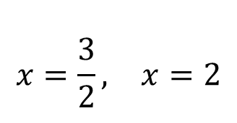
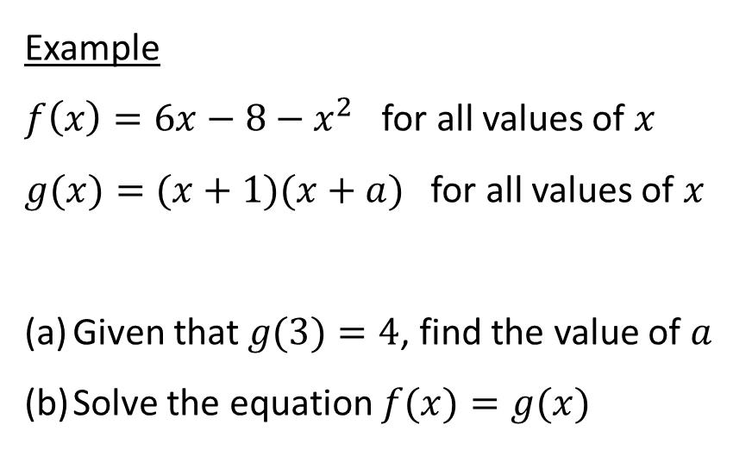
Example
$f\left(x\right)=6x−8−x^{2}$for all values of $x$
$g(x)=(x+1)(x+a)$for all values of $x$
Given that $g(3)=4$, find the value of $a$
Solve the equation $f(x)=g(x)$
(a)
(b)
$$f(x)=g(x)$$
$$g(3)=4$$
$$6x−8−x^{2}=\left(x+1\right)\left(x−2\right)$$
$$\left(3+1\right)\left(3+a\right)=4$$
$$4\left(3+a\right)=4$$
$$6x−8−x^{2}=x^{2}−x−2$$
$$\left(3+a\right)=1$$
$$0=2x^{2}−7x+6$$
$$a=−2$$
$$0=\left(2x−3\right)\left(x−2\right)$$
$$\begin{matrix}x=\frac{3}{2}, & x=2\end{matrix}$$

Slide 7
Example
Given $f\left(x\right)=x^{2}−3x−4$ obtain an expression for $f\left(x+2\right)$
$f\left(x\right)=x^{2}−3x−4$
$f\left(x+2\right)={\left(x+2\right)}^{2}−3\left(x+2\right)−4$
$f\left(x+2\right)=x^{2}+4x+4−3x−6−4$
$f\left(x+2\right)=x^{2}+x−6$

Slide 8
Questions
The function $f(x)$ is defined as
$f\left(x\right)=x^{2}−9$ $0≤x≤5$
(a) Work out the value of $f(2)$
(b) Work out the value of $f(5)$
(c) Solve $f(x)=0$
(d) Work out the highest value f(x) could be
$$f(2) =$$
$$f\left(5\right)=$$
$$x=$$
Highest value=

Slide 9

2. Given $f\left(x\right)=x^{2}+3x−6$ calculate the values of
(i) $f\left(5\right)$ (ii) $f\left(0\right)$ (iii) $f\left(−2\right)$
Hence solve $f\left(x\right)=4$
$$x=$$

Slide 10
3. Given $f\left(x\right)=4x−5.$
Obtain an expression for $f\left(x+1\right)$
$$f\left(x+1\right)=$$
4. Given $g\left(x\right)=x^{2}−2x+1.$
Obtain an expression for $g\left(x−2\right)$
$$g\left(x−2\right)=$$

Slide 11

5. Given that $f\left(x\right)=4x^{2}+3x−2$, solve the equation
(a) $f\left(x\right)=5$
(b) $f\left(a\right)=3a$
$$x=$$
$$a=$$

Slide 12
6. Given $g\left(x\right)=2x^{2}−x+1$ solve the equation
$g\left(a\right)=g\left(2a\right)$
$$a=$$

Slide 13
7. Given $f\left(x\right)=x^{2}+2x−3$ solve the equation
$$f\left(x+1\right)=f\left(x−1\right)$$
$$x=$$

Slide 14
8. The functions f and g are defined as
$$f\left(x\right)=3x^{2}−2$$
$$g\left(x\right)=cx−7$$
Given that $f\left(3\right)=g\left(3\right)$ find the value of $c$
$$c=$$

