Slide 1
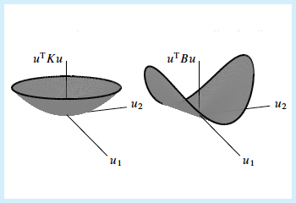
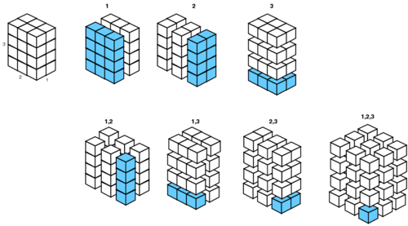
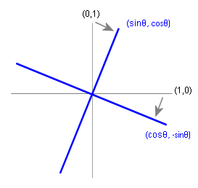
Matrix Algebra (5)

Slide 2
Starter
Calculate the following:
Also, calculate the determinant of the answer!
$$\left[\begin{matrix}4 & 6 \\ 3 & −5\end{matrix}\right]\left[\begin{matrix}2 & −6 \\ 7 & −1\end{matrix}\right]$$
$$=\left[\begin{matrix}50 & −30 \\ −29 & −13\end{matrix}\right]$$
$$\left[\begin{matrix}a & b \\ c & d\end{matrix}\right]$$
$$=ad−bc$$
$$=\left(50×−13\right)−(−30×−29)$$
$$=−1520$$

Slide 3
Matrix Algebra (5)
You need to be able to find the inverse of a Matrix
As you saw last lesson, the inverse of a Matrix is the Matrix you multiply it by to get the Identity Matrix:
Remember that this is the Matrix equivalent of the number 1. Multiplying another 2x2 matrix by this will leave the answer unchanged.
Also remember that from last lesson, the determinant of a matrix is given by:
Given:
$$A=\left[\begin{matrix}a & b \\ c & d\end{matrix}\right]$$
$$A^{−1}=\frac{1}{ad−bc}\left[\begin{matrix}d & −b \\ −c & a\end{matrix}\right]$$
$$\left[\begin{matrix}1 & 0 \\ 0 & 1\end{matrix}\right]$$
This means ‘the inverse of A’
Remember this part is the ‘determinant’
Pay attention to how these numbers have changed!
$$\left|A\right|=ad−bc$$
for
$$A=\left[\begin{matrix}a & b \\ c & d\end{matrix}\right]$$

Slide 4
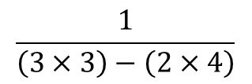
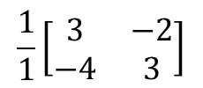
Matrix Algebra (5)
$$A=\left[\begin{matrix}a & b \\ c & d\end{matrix}\right]$$
$$A^{−1}=\frac{1}{ad−bc}\left[\begin{matrix}d & −b \\ −c & a\end{matrix}\right]$$
You need to be able to find the inverse of a Matrix
Find the inverse of the matrix given below:
$$A=\left[\begin{matrix}3 & 2 \\ 4 & 3\end{matrix}\right]$$
Replace the numbers as above
$$\frac{1}{\left(3×3\right)−\left(2×4\right)}$$
$$\left[\begin{matrix}3 & −2 \\ −4 & 3\end{matrix}\right]$$
$$A^{−1}=$$
$$\left[\begin{matrix}3 & 2 \\ 4 & 3\end{matrix}\right]$$
Work out the fraction…
$$\frac{1}{1}\left[\begin{matrix}3 & −2 \\ −4 & 3\end{matrix}\right]$$
$$A^{−1}=$$
… which in this case you don’t need to write!
$$A^{−1}=$$
$$\left[\begin{matrix}3 & −2 \\ −4 & 3\end{matrix}\right]$$
$$So: \left[\begin{matrix}3 & 2 \\ 4 & 3\end{matrix}\right]\left[\begin{matrix}3 & −2 \\ −4 & 3\end{matrix}\right]=\left[\begin{matrix}1 & 0 \\ 0 & 1\end{matrix}\right]$$

Slide 5
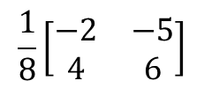
Matrix Algebra (5)
$$A=\left[\begin{matrix}a & b \\ c & d\end{matrix}\right]$$
$$A^{−1}=\frac{1}{ad−bc}\left[\begin{matrix}d & −b \\ −c & a\end{matrix}\right]$$
You need to be able to find the inverse of a Matrix
Find the inverse of the matrix given below:
$$A=\left[\begin{matrix}6 & −5 \\ 4 & −2\end{matrix}\right]$$
Replace the numbers as above
$$\frac{1}{\left(6×−2\right)−\left(4×−5\right)}$$
$$\left[\begin{matrix}−2 & −5 \\ 4 & 6\end{matrix}\right]$$
$$A^{−1}=$$
$$\left[\begin{matrix}6 & −5 \\ 4 & −2\end{matrix}\right]$$
Work out the fraction…
$$\frac{1}{8}\left[\begin{matrix}−2 & −5 \\ 4 & 6\end{matrix}\right]$$
$$A^{−1}=$$
You can include the fractional part in the Matrix
→ Obviously you would simplify the fractions if you did!
$$So: \left[\begin{matrix}6 & −5 \\ 4 & −2\end{matrix}\right]\left[\begin{matrix}−2/8 & −5/8 \\ 4/8 & 6/8\end{matrix}\right]=\left[\begin{matrix}1 & 0 \\ 0 & 1\end{matrix}\right]$$

Slide 6
Matrix Algebra (5)
You need to be able to find the inverse of a Matrix
It is important to note that not every Matrix actually has an inverse!
$$A=\left[\begin{matrix}a & b \\ c & d\end{matrix}\right]$$
$$A^{−1}=\frac{1}{ad−bc}\left[\begin{matrix}d & −b \\ −c & a\end{matrix}\right]$$
If this calculation is equal to 0, the Matrix does not have an inverse
→ The reason is that we are not able to divide by 0!

Slide 7
Plenary
$$A=\left[\begin{matrix}a & b \\ c & d\end{matrix}\right]$$
$$A^{−1}=\frac{1}{ad−bc}\left[\begin{matrix}d & −b \\ −c & a\end{matrix}\right]$$
Calculate the values of a, b, c and d in the calculation below using Simultaneous equations.
$$\left[\begin{matrix}4 & −8 \\ −3 & 6\end{matrix}\right]\left[\begin{matrix}a & b \\ c & d\end{matrix}\right]=\left[\begin{matrix}1 & 0 \\ 0 & 1\end{matrix}\right]$$
$$\left(4×a\right)+(−8×c)$$
$$\left(4×b\right)+(−8×d)$$
$$\left(−3×a\right)+(6×c)$$
$$\left(−3×b\right)+(6×d)$$
Comparing the algebraic versions to the answer above…
x3
$$4a−8c$$
$$4b−8d$$
$$4a−8c=1$$
$$12a−24c=3$$
$$−3a+6c$$
$$−3b+6d$$
$$−3a+6c=0$$
x4
$$−12a+24c=0$$
However you try to eliminate a or c, the other will be eliminated too so the equations are not solvable
The implication is that the Matrix above has no inverse
You will see that if you calculated the determinant, it is equal to 0!

Slide 8
Summary
We have seen how to calculate the inverse of a Matrix
You have seen that this is based on the determinant, and some adjusting of the Matrix itself
Inverse Matrices can be sued to solve simultaneous equations!

