Slide 1
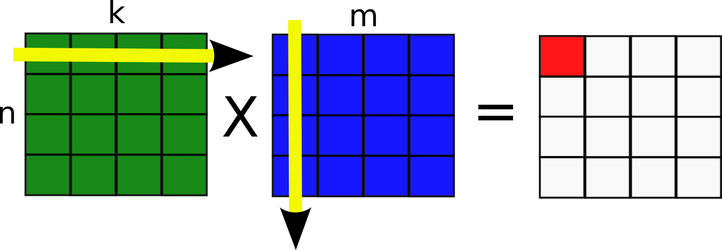
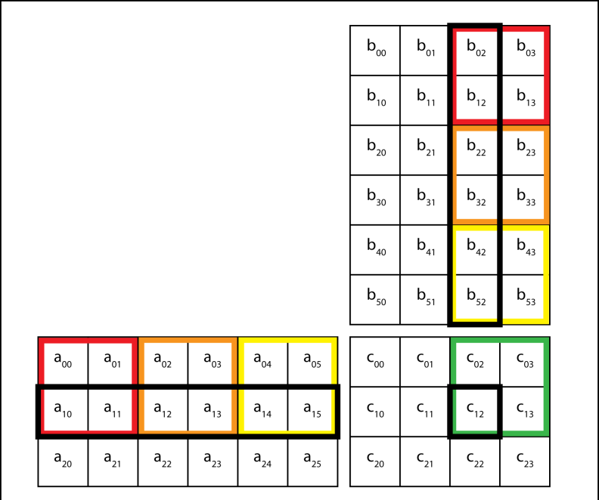
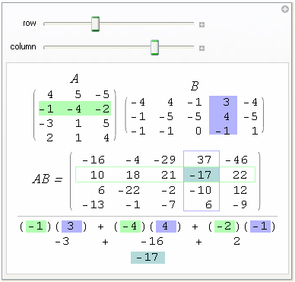
Matrix Algebra (3)

Slide 2
Starter
Find the value of x in each of the following Matrices:
a)
b)
$$\left[\begin{matrix}6 & 5\end{matrix}\right]$$
$$\left[\begin{matrix}3 \\ 4\end{matrix}\right]$$
$$=\left[x\right]$$
$$\left[\begin{matrix}x & 5\end{matrix}\right]$$
$$\left[\begin{matrix}x \\ 3\end{matrix}\right]$$
$$=\left[31\right]$$
$$\left(6×3\right)+\left(5×4\right)=x$$
$$\left(x×x\right)+\left(5×3\right)=31$$
Work out brackets
Calculate
$$38=x$$
$$x^{2}+15=31$$
Subtract 15
$$x^{2}=16$$
Square root
c)
$$\left[\begin{matrix}3 \\ 9\end{matrix}\right]$$
$$x=±4$$
$$\left[\begin{matrix}x^{2} & 1\end{matrix}\right]$$
$$=\left[84\right]$$
$$\left(x^{2}×3\right)+\left(1×9\right)=84$$
Work out brackets
$${3x}^{2}+9=84$$
Subtract 9
$${3x}^{2}=75$$
Divide by 3
$$x^{2}=25$$
Square root
$$x=±5$$

Slide 3
Matrix Algebra (3)
We have looked at addition and subtraction of Matrices
We have also looked at some multiplication of Matrices
Today we will be looking at multiplying more complex Matrices together
This can be a little confusing – make sure you show lots of working as done on the board. This is the best way for you to learn to do it quickly in the long run!
We will look at an example of where Matrices came from towards the end so you can see why the operations are done in this way!

Slide 4
Matrix Algebra (3)
Multiplying Matrices together
Lets have a quick reminder of last lesson!
Remember you multiply the terms in the row by their corresponding terms in the column
Then we calculate the sum of these multiplications
a) Calculate the value of the following:
$$\left[\begin{matrix}3 \\ 7 \\ 4\end{matrix}\right]$$
$$\left[\begin{matrix}4 & 6 & −1\end{matrix}\right]$$
$$\left(4×3\right)$$
$$+ \left(6×7\right)$$
$$+ \left(−1×4\right)$$
$$=50$$

Slide 5
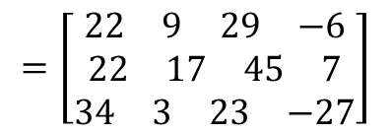

Matrix Algebra (3)
Multiplying Matrices together
Matrices can only be multiplied if the number of columns in the first is the same as the number of rows in the second.
$$\left[\begin{matrix}5 \\ 5 \\ 8\end{matrix}\right]$$
$$\left[\begin{matrix}\begin{matrix}3 & 2\end{matrix} \\ \begin{matrix}2 & 5\end{matrix} \\ \begin{matrix}6 & −1\end{matrix}\end{matrix}\right]$$
$$=\left[\begin{matrix}\begin{matrix}\begin{matrix}22 & 9\end{matrix} & \begin{matrix}29 & −6\end{matrix}\end{matrix} \\ \begin{matrix}\begin{matrix}22 & 17\end{matrix} & \begin{matrix}45 & 7\end{matrix}\end{matrix} \\ \begin{matrix}\begin{matrix}34 & 3\end{matrix} & \begin{matrix}23 & −27\end{matrix}\end{matrix}\end{matrix}\right]$$
$$\left[\begin{matrix}6 & 5 & −2\end{matrix}\right]$$
$$=\left[39\right]$$
$$\left[\begin{matrix}\begin{matrix}6 & 1 \\ 2 & 3\end{matrix} & \begin{matrix}5 & −4 \\ 7 & 3\end{matrix}\end{matrix}\right]$$
1 x 3
3 x 1
1 x 1
3 x 2
2 x 4
3 x 4
These numbers have to be the same!
These numbers have to be the same!
These numbers give the dimensions of the final matrix!
These numbers give the dimensions of the final matrix!

Slide 6
Matrix Algebra (3)
Multiplying Matrices together
When you have more difficult matrices, follow these steps:
Write the order of the matrices, and hence the order of the answer.
Take the first row of the first matrix, and multiply it by the first column of the second (as you have been doing up until now). Remember these will be added together (write the sum out first…)
Then continue using the first row and multiply by the next column (if there is one). Write the answer down next to the first (horizontally)
Once you have used the first row with all the columns, repeat the process but with the second row, (if there is one!) writing these answers below the first set
Continue until you have used all the rows with all the columns
Then calculate each sum – it will already be set out in the correct position!
Lets see an example!
Calculate the following:
$$\left[\begin{matrix}5 & 6\end{matrix}\right]$$
$$\left[\begin{matrix}\begin{matrix}3 \\ 4\end{matrix} & \begin{matrix}1 \\ 2\end{matrix}\end{matrix}\right]$$
$$=\left[\begin{matrix} & \end{matrix}\right]$$
1 x 2
2 x 2
1 x 2
$$\left(5×3\right)+(6×4)$$
$$\left(5×1\right)+(6×2)$$
$$=\left[\begin{matrix}39 & 17\end{matrix}\right]$$

Slide 7
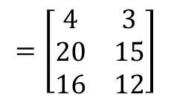
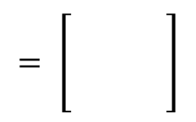
Matrix Algebra (3)
Multiplying Matrices together
When you have more difficult matrices, follow these steps:
Write the order of the matrices, and hence the order of the answer.
Take the first row of the first matrix, and multiply it by the first column of the second (as you have been doing up until now). Remember these will be added together (write the sum out first…)
Then continue using the first row and multiply by the next column (if there is one). Write the answer down next to the first (horizontally)
Once you have used the first row with all the columns, repeat the process but with the second row, (if there is one!) writing these answers below the first set
Continue until you have used all the rows with all the columns
Then calculate each sum – it will already be set out in the correct position!
Lets see an example!
Calculate the following:
$$\left[\begin{matrix}1 \\ 5 \\ 4\end{matrix}\right]$$
$$= \left[\begin{matrix} & \\ & \\ & \end{matrix}\right]$$
$$\left[\begin{matrix}4 & 3\end{matrix}\right]$$
3 x 1
1 x 2
3 x 2
$$\left(1×4\right)$$
$$(1×3)$$
$$\left(5×4\right)$$
$$(5×3)$$
$$\left(4×4\right)$$
$$(4×3)$$
$$=\left[\begin{matrix}4 & 3 \\ 20 & 15 \\ 16 & 12\end{matrix}\right]$$

Slide 8
Matrix Algebra (3)
Multiplying Matrices together
When you have more difficult matrices, follow these steps:
Write the order of the matrices, and hence the order of the answer.
Take the first row of the first matrix, and multiply it by the first column of the second (as you have been doing up until now). Remember these will be added together (write the sum out first…)
Then continue using the first row and multiply by the next column (if there is one). Write the answer down next to the first (horizontally)
Once you have used the first row with all the columns, repeat the process but with the second row, (if there is one!) writing these answers below the first set
Continue until you have used all the rows with all the columns
Then calculate each sum – it will already be set out in the correct position!
Lets see an example!
Calculate the following:
$$\left[\begin{matrix}1 & 3 \\ −5 & 0\end{matrix}\right]$$
$$\left[\begin{matrix}3 & 7 \\ 4 & −1\end{matrix}\right]$$
$$=\left[\begin{matrix} & \\ & \end{matrix}\right]$$
2 x 2
2 x 2
2 x 2
$$\left(1×3\right)+(3×4)$$
$$\left(1×7\right)+(3×−1)$$
$$\left(−5×3\right)+(0×4)$$
$$\left(−5×7\right)+(0×−1)$$
$$=\left[\begin{matrix}15 & 4 \\ −15 & −35\end{matrix}\right]$$

Slide 9
Plenary
Why do we multiply matrices like this?
→ Matrices were originally developed as a method to solve and rearrange multiple linear equations and expressions
Mathematicians realised that for more complicated equations, they needed a more efficient method…
→ They wrote the sets of equations as matrices and multiplied them using the method you have seen!
$$u=3x+7y$$
Here we have two pairs of equations
Write p and q in terms of x and y
→ Substitute the first equations into the second…
$$u=3x+7y$$
$$v=−2x+11y$$
$$v=−2x+11y$$
$$p=13u−20v$$
$$p=13u−20v$$
$$q=2u+6v$$
$$q=2u+6v$$
Replace the u terms and the v terms
$$\left[\begin{matrix}\begin{matrix}13 & −20\end{matrix} \\ \begin{matrix}2 & 6\end{matrix}\end{matrix}\right]$$
$$\left[\begin{matrix}\begin{matrix}3 & 7\end{matrix} \\ \begin{matrix}−2 & 11\end{matrix}\end{matrix}\right]$$
$$p=13(3x+7y)−20(−2x+11y)$$
$$q=2(3x+7y)+6(−2x+11y)$$
$$\left(13×3\right)+(−20×−2)$$
$$\left(13×7\right)+(−20×11)$$
$$\left(2×3\right)+(6×−2)$$
$$\left(2×7\right)+(6×11)$$
Multiply out and simplify
$$p=79x−129y$$
$$=\left[\begin{matrix}\begin{matrix}79 & −129\end{matrix} \\ \begin{matrix}−6 & 70\end{matrix}\end{matrix}\right]$$
$$q=−6x+70y$$
This method then stuck and is the way matrix multiplication has been defined ever since!

Slide 10
Summary
We have seen which types of Matrix it is possible to multiply
We have seen how to perform the calculations
You have also seen how important it is to lay out your work clearly!

