Slide 1
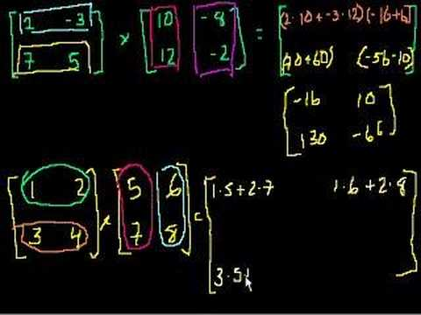
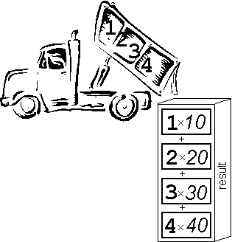
Matrix Algebra (2)

Slide 2
Starter
Example source
The table below to the right shows the number of different types of pie sold in a shop over 4 days. The table to the left shows the selling price of each type of pie. Calculate the revenue for each day and summarise your answers in a table.
Beef | Chicken | Vegetable
£3 | £4 | £2
Type | Mon | Tue | Wed | Thur
Beef | 13 | 9 | 7 | 15
Chicken | 8 | 7 | 4 | 6
Vegetable | 6 | 4 | 0 | 3
Effectively you multiply this row by each column to the right!
Monday
Tuesday
Wednesday
Thursday
(3 x 13) + (4 x 8) + (2 x 6)
(3 x 9) + (4 x 7) + (2 x 4)
(3 x 7) + (4 x 4) + (2 x 0)
(3 x 15) + (4 x 6) + (2 x 3)
= £83
= £63
= £37
= £75
Mon | Tue | Wed | Thur
£83 | £63 | £37 | £75

Slide 3

Starter
Example source
The table below to the right shows the number of different types of pie sold in a shop over 4 days. The table to the left shows the selling price of each type of pie. Calculate the revenue for each day and summarise your answers in a table.
Beef | Chicken | Vegetable
£3 | £4 | £2
Type | Mon | Tue | Wed | Thur
Beef | 13 | 9 | 7 | 15
Chicken | 8 | 7 | 4 | 6
Vegetable | 6 | 4 | 0 | 3
As Matrices, this is what the calculation you did looks like…
Multiply the ROW in the first matrix by the COLUMNS in the second!
$$\left[\begin{matrix}\begin{matrix}13 & 9 \\ 8 & 7 \\ 6 & 4\end{matrix} & \begin{matrix}7 & 15 \\ 4 & 6 \\ 0 & 3\end{matrix}\end{matrix}\right]$$
$$\left[\begin{matrix}3 & 4 & 2\end{matrix}\right]$$
$$=\left[\begin{matrix}\begin{matrix}83 & 63\end{matrix} & \begin{matrix}37 & 75\end{matrix}\end{matrix}\right]$$
1 x 4
1 x 3
3 x 4
It is possible to multiply matrices of different dimensions!
→ Do you notice any ‘pattern’ in the dimensions of the matrices we multiplied?

Slide 4
Matrix Algebra (2)
Last lesson we saw how to perform addition and subtraction using matrices
Today we will be looking at multiplication using matrices
This can be a little unusual to begin with and requires very clear workings

Slide 5
Matrix Algebra (2)
You need to be able to multiply a matrix by a number, as well as another matrix
Calculate:
2A
-3A
a)
$$A=\left[\begin{matrix}5 & 2 \\ −4 & 0\end{matrix}\right]$$
Just multiply each part by 2
$$2A=\left[\begin{matrix}10 & 4 \\ −8 & 0\end{matrix}\right]$$
$$A=\left[\begin{matrix}5 & 2 \\ −4 & 0\end{matrix}\right]$$
b)
$$A=\left[\begin{matrix}5 & 2 \\ −4 & 0\end{matrix}\right]$$
Just multiply each part by -3
$$−3A=\left[\begin{matrix}−15 & −6 \\ 12 & 0\end{matrix}\right]$$
So to multiply a matrix by a number, you just multiply each part in the matrix separately

Slide 6
Matrix Algebra (2)
You need to be able to multiply a matrix by a number, as well as another matrix
To multiply matrices together, multiply each ROW in the first, by each COLUMN in the second (like in the starter)
→ Remember for each row and column pair, you need to sum the answers!
a) Calculate the following
$$\left[\begin{matrix}4 \\ 6 \\ 1\end{matrix}\right]$$
$$\left[\begin{matrix}2 & 5 & 3\end{matrix}\right]$$
→ Multiply each number in the row with the corresponding number in the column
$$\left(2×4\right)$$
$$+ \left(5×6\right)$$
$$+ \left(3×1\right)$$
$$=41$$

Slide 7

Matrix Algebra (2)
You need to be able to multiply a matrix by a number, as well as another matrix
To multiply matrices together, multiply each ROW in the first, by each COLUMN in the second (like in the starter)
→ Remember for each row and column pair, you need to sum the answers!
b) Calculate the following:
$$\left[\begin{matrix}\begin{matrix}4 \\ −2\end{matrix} \\ \begin{matrix}1 \\ 5\end{matrix}\end{matrix}\right]$$
$$\left[\begin{matrix}\begin{matrix}−3 & 0\end{matrix} & \begin{matrix}1 & 2\end{matrix}\end{matrix}\right]$$
→ Multiply each number in the row with the corresponding number in the column
$$\left(−3×4\right)$$
$$+ \left(0×−2\right)$$
$$+ \left(1×1\right)$$
$$+ \left(2×5\right)$$
$$=−1$$
Show workings like these – it is essential to to have a good routine in place when we move onto bigger Matrices!

Slide 8
Plenary
The values of x and y in these pairs of Matrices are the same. Calculate what x and y must be!
$$\left[\begin{matrix}x & y\end{matrix}\right]\left[\begin{matrix}5 \\ 3\end{matrix}\right]=\left[20\right]$$
$$\left[\begin{matrix}y & −2\end{matrix}\right]\left[\begin{matrix}2 \\ x\end{matrix}\right]=\left[−24\right]$$
$$\left[\begin{matrix}x & y\end{matrix}\right]\left[\begin{matrix}5 \\ 3\end{matrix}\right]=\left[20\right]$$
As an equation
Multiply by 2
$$5x+3y=20$$
$$10x+6y=40$$
$$\left[\begin{matrix}y & −2\end{matrix}\right]\left[\begin{matrix}2 \\ x\end{matrix}\right]=\left[−24\right]$$
As an equation
Multiply by 5
$$2y−2x=−24$$
$$10y−10x=−120$$
Add the two equations together
$$16y=−80$$
Divide by 16
$$y=−5$$
Then find x
$$x=7$$

Slide 9
Summary
We have looked at multiplying some Matrices
You have seen that as there is more to think about here, workings are very important
Next lesson we will be looking at multiplying matrices with multiple rows AND columns!

