Slide 1
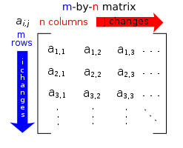
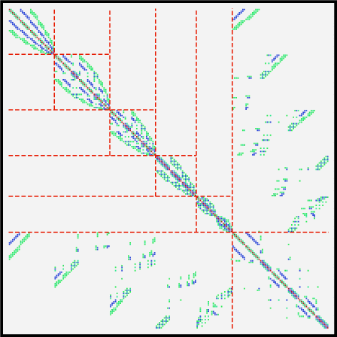
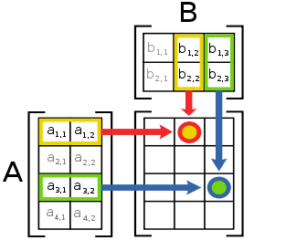
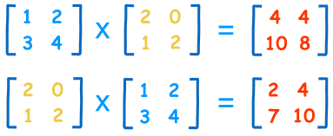
Matrix Algebra (1)

Slide 2
Starter
These tables show information on items sold in 2 different shops over several days. Summarise the information into a single table.
Shop A
TVs
Radios
Phones
Shop B
TVs
Radios
Phones
DAY 1
7
3
12
DAY 1
8
4
14
DAY 2
6
2
8
DAY 2
3
6
10
DAY 3
7
2
9
DAY 3
9
5
11
DAY 4
10
4
11
DAY 4
12
5
12
You can summarise the table by adding corresponding columns together!
TOTAL
TVs
Radios
Phones
DAY 1
15
7
26
DAY 2
9
8
18
DAY 3
16
7
20
DAY 4
22
9
23

Slide 3



Starter
These tables show information on items sold in 2 different shops over several days. Summarise the information into a single table.
Shop A
TVs
Radios
Phones
Shop B
TVs
Radios
Phones
DAY 1
7
3
12
DAY 1
8
4
14
DAY 2
6
2
8
DAY 2
3
6
10
DAY 3
7
2
9
DAY 3
9
5
11
DAY 4
10
4
11
DAY 4
12
5
12
Mathematically, this is the start of ‘Matrix Algebra’
It is a method computers use to add up large amounts of data
It is also used in computer animation, as matrices can transform the shapes of objects!
We can use matrices to represent the information above…
$$\left[\begin{matrix}\begin{matrix}7 & 3 & 12 \\ 6 & 2 & 8\end{matrix} \\ \begin{matrix}7 & 2 & 9 \\ 10 & 4 & 11\end{matrix}\end{matrix}\right]$$
$$+\left[\begin{matrix}\begin{matrix}8 & 4 & 14 \\ 3 & 6 & 10\end{matrix} \\ \begin{matrix}9 & 5 & 11 \\ 12 & 5 & 12\end{matrix}\end{matrix}\right]$$
$$=\left[\begin{matrix}\begin{matrix}15 & 7 & 26 \\ 9 & 8 & 18\end{matrix} \\ \begin{matrix}16 & 7 & 20 \\ 22 & 9 & 23\end{matrix}\end{matrix}\right]$$

Slide 4
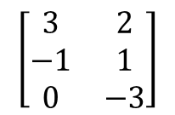
Matrix Algebra
To begin with, you need to know how to solve problems involving the addition and subtraction of matrices, and be able to state the ‘order’ of a matrix (its dimensions)
The order of a matrix is (n x m) where n is the number of rows and m is the number of columns
Write the dimensions of the following matrices
$$\left[\begin{matrix}2 & −1 \\ 1 & 3\end{matrix}\right]$$
b)
$$\left[\begin{matrix}1 & 0 & 2\end{matrix}\right]$$
→ 2 rows
→ 1 row
→ 2 columns
→ 3 columns
→ The matrix is 2 x 2
→ The matrix is 1 x 3
$$\left[\begin{matrix}4 \\ −1\end{matrix}\right]$$
d)
$$\left[\begin{matrix}3 & 2 \\ −1 & 1 \\ 0 & −3\end{matrix}\right]$$
→ 2 rows
→ 3 rows
→ 1 column
→ 2 columns
→ The matrix is 2 x 1
→ The matrix is 3 x 2

Slide 5
Matrix Algebra
To begin with, you need to know how to solve problems involving the addition and subtraction of matrices, and be able to state the ‘order’ of a matrix (its dimensions)
You can add and subtract matrices only when they have the same dimensions
Calculate A + B
$$\left[\begin{matrix}5 & 7 & 4 \\ −6 & −2 & 3\end{matrix}\right]+\left[\begin{matrix}8 & −2 & 0 \\ −3 & 8 & −1\end{matrix}\right]$$
$$=\left[\begin{matrix} & & \\ & & \end{matrix}\right]$$
$$13$$
$$5$$
$$4$$
$$−9$$
$$6$$
$$2$$
Calculate A - B
$$\left[\begin{matrix}5 & 7 & 4 \\ −6 & −2 & 3\end{matrix}\right]−\left[\begin{matrix}8 & −2 & 0 \\ −3 & 8 & −1\end{matrix}\right]$$
$$A=\left[\begin{matrix}5 & 7 & 4 \\ −6 & −2 & 3\end{matrix}\right]$$
$$=\left[\begin{matrix} & & \\ & & \end{matrix}\right]$$
$$−3$$
$$9$$
$$4$$
$$−3$$
$$−10$$
$$4$$
$$B=\left[\begin{matrix}8 & −2 & 0 \\ −3 & 8 & −1\end{matrix}\right]$$

Slide 6
Plenary
Calculate the values of x and y in the matrix equation below.
$$\left[\begin{matrix}2x & 4 \\ 3 & x\end{matrix}\right]+\left[\begin{matrix}3y & 7 \\ 2 & −y\end{matrix}\right]=\left[\begin{matrix}5 & 11 \\ 5 & 5\end{matrix}\right]$$
1)
$$2x+3y=5$$
1)
$$2x+3y=5$$
2)
$$x−y=5$$
Multiply all by 3
2)
$$3x−3y=15$$
Add 1) and 2)
$$5x=20$$
$$x=4$$
Divide by 5
You can then find y by substitution!
$$y=−1$$

Slide 7
Summary
We have learnt about Matrix Algebra and seen why it exists
We have seen how to write the ‘order’ of a Matrix
We have seen how to perform Addition and Subtraction using matrices!

